Slide 1

Student Results Management System
23531 SHAMI Kelly NIKUze
Web technology project

Slide 2
Table of content: 1. Introduction 2. The main objective 3. Methodology 4. Future implements 5.Conclusion 6.Bibliography
23531 SHAMI KELLY NIKUZE
WEB technology Project
Monday group

Slide 3
Introduction
Student Result Management System is a web-based application that mainly focuses on providing the results to the student and the faculty. The student check their respective results using their University registered recognition id’s along with their grades and percentage of that particular semester. The student accessing their results through college site is more convenient and the faculty can easily analyses the pass and failure of a particular subject. The system is divided into three modules- Student, Faculty and Administrator. The student using his roll number can view his results and the faculty using the joining year and the subject name and view the analysis of pass and failure count in the selected subject . The administrator uploads the results file to the database by converting the file to sql format(.sql) from the PDF format(.pdf).The admin is provided with the privileges to modify the student results by updating the results during the changes in supplementary or revaluation examination. The update of any current score is to done by the administrator.

Slide 4
The main objective
The main objective of this project is to provide results to the students in a simple way. The students can get results through the college/institution website through their roll numbers. By analyzing the result status and applying the standard calculation followed by the University the result are displayed with individual scores and the equivalent percentage. The system is intended for the student. The student can login through their login id and password to check their respective results. This can be achieved with web development technologies like Springboot Framework, HTML, CSS, Thymeleaf, JavaScript and using the database MySQL. The faculty can view the overall performance of the students in the semester examinations subject wise. The visualization of the overall results according to the subject(The percentage of pass and fail in a particular subject) can be done using fusion charts.

Slide 5
METHODOLOGY
There are three modules.
• Student
• Faculty
• Admin
They are The system can be developed using web technologies Spring boot MVC, Thymeleaf, CSS, and using the database MySQL. The front end can consist of user registration with the respective university registered number and the password by the user. The student can view his results in the tabular format with the respective aggregate and percentage of that semester. The data based on the roll number of the student all the data can be retrieved back to the table and displayed as results. The PHP can also be used for visualization of data. We use fusion charts for the dynamic visualization Primarily the data can be collected from the college administration. This data includes university registered number of every student currently collected is then classified and tabulated into useful and understandable manner. HTML is used for structuring the web page and its content. It is used to develop different pages like user registration, login page and the page for providing results. CSS is used for styling the web page. PHP is used for connecting to the database and perform operations on it through queries

Slide 6
FUTURE IMPLEMENTS
In near future, the system interface could be improved, with more attractive, interactive and meaningful images; enhance the system with an email and SMS or email notifications. Enhance the current system by computerizing almost all the services provided by the institution ,turning it into a complete LMS. And evolve the system by developing several versions through users feedback. if a complete solution has not been worked out.

Slide 7
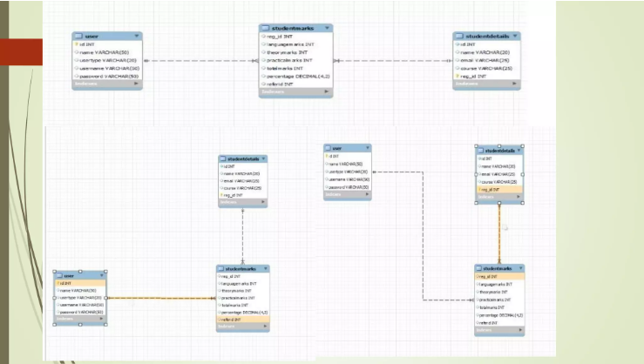

Slide 8
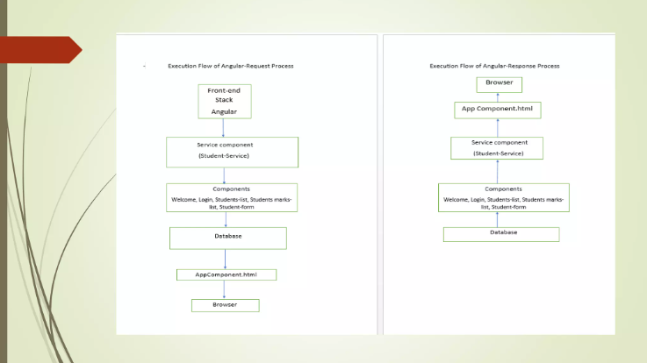

Slide 9
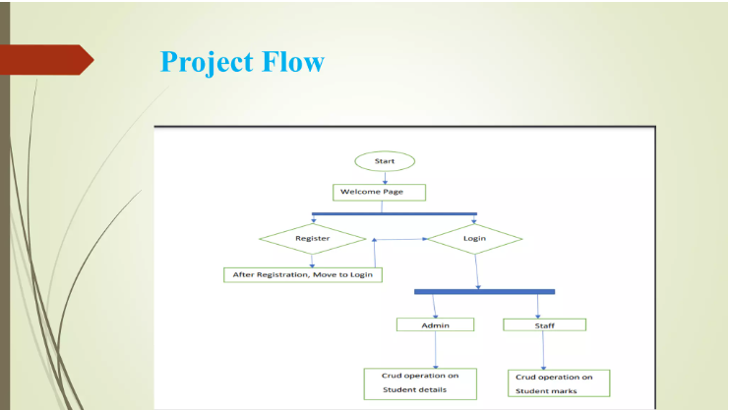

Slide 10
Conclusion
Student result management system is an online website and can be used at any place, any time and by any student or faculty. This application will avoid the calculation and simplify the process of visualizing results by students as well as faculty.

Slide 11
References and Bibliography
.Google

